Slide 1
Git, GitHub, and RStudio
Mayra Trujillo | November 14, 2022

Slide 2


What are Git and GitHub?
Git
  Version control system on your local computer
  Snapshots of your code
  .git/ folder = repository
GitHub
  A webservice that allows you to host Git
  Collaboration
  Source code management
Image Source: https://git-scm.com/downloads/logos
Image Source: https://github.com/logos
Notes:
Git is a version control system that keeps track of your changes of files over time. You can think of each change or version of your file as a snapshot. It creates a record of these changes like a history which is stored in the dot git folder.
GitHub is a webservice that stores your project files on the web allowing collaborators to coordinate from anywhere in the world. Has multiple source code management features. So you can: authenticate users, online based editing of files, limit interactions among collaborators or files.

Slide 3
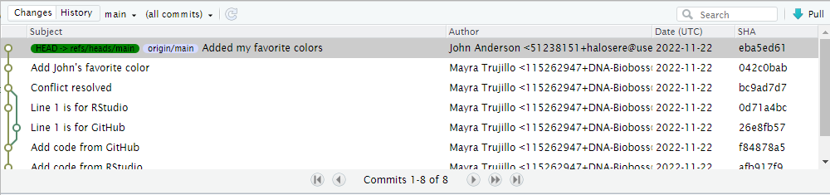
What are Git and GitHub?...continued
Notes:
You can see on this history, that the most current version of my file or code is at the top. By using Git, I can see all the previous versions of my code. If I ever need to refer to code, that I may have deleted in my current code, but saved in a previous version I can pull that right up. So you’ll always have peace of mind, knowing that you’ll previous coding will always be available to you even it has been removed from your current code.

Slide 4
What are Git and GitHub?
Git
  Version control system on your local computer
  Snapshots of your code
  .git/ folder = repository
GitHub
  A webservice that allows you to host Git
  Collaboration
  Source code management
Image Source: https://git-scm.com/downloads/logos
Image Source: https://github.com/logos
Notes:
Git is a version control system that keeps track of your changes of files over time. You can think of each change or version of your file as a snapshot. It creates a record of these changes like a history which is stored in the dot git folder.
GitHub is a webservice that stores your project files online allowing collaborators to coordinate from anywhere in the world. Has multiple source code management features. So you can: authenticate users, online based editing of files, limit interactions among collaborators or files.

Slide 5
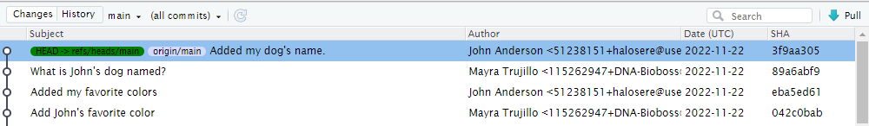
Why use Git and GitHub
Version Control
  Previous versions of your code
Backup
    In sync
    Push to repository
Collaboration
    Working on the same project at the same time
Image Source: Mayra’s History on local RStudio
Notes:
Using Git and GitHub allows you to use version control. What is version control? Ever had documents called report, report-edits, report-final? I know I have. Instead of making copies of files over fear of losing work, version control allows you to see what you did in the past, all while keeping single versions of documents. This also allows you to revert to a previous version of your file if you end up “breaking” your code.
Using Git and GitHub serves as a backup. Because GitHub has a copy of all the code you have locally, if anything were to happen to your computer, you’d still have access to your code. This is ONLY true if consistently upload your code aka Push to repository but more on that later.
Using Git and GitHub makes it possible to work on the same project at the same time as collaborators. Many collaborators prefer working with Git/GitHub instead using other cloud storage services such as: Dropbox, Google Drive, OneDrive. B/c the biggest issue they run into is that only one person can work on an RStudio project shared in this way. By using Git and GitHub, not only does each collaborator have a copy of the whole file but each collaborator can work on a different section of the code at the same time and later merge those changes, so large projects can be handled efficiently.

Slide 6

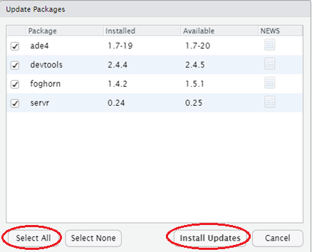
Setup: Update Everything!
Update
  R
    https://cran.microsoft.com/
  RStudio
    https://posit.co/download/rstudio-desktop/#download
  Packages
    Packages tab
    Click green icon “Update”
    Select all > Install Updates
Notes:
Before installing Git, you’ll want to update everything first. The majority of issues of installing Git arise from ppl using older versions which can be avoided with a simple update. You’ll need to update 3 thing: R, Rstudio, and your packages. I believe you’ll have to submit a ticket to IT to get R and RStudio updated BUT for right now we’ll try connecting Git with just updating the Packages.
Under the packages tab you can see all the packages you’ve installed. So to update them, you’ll click the green Update icon > Select All > then Install Updates. We’ll let that run. And now they should be updated. We can verify this, by selecting update again, you’ll see that all packages are up-to-date.

Slide 7
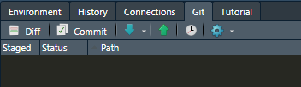
Git ’R Done!
Download and Install Git (if necessary)
    https://git-scm.com/downloads
    Terminal tab: git --version
Configure Git
  Console tab
    Install and load package “usethis”
      library(“usethis”)
      use_git_config(user.name = “First Last”, user.email = email.address@example.com)
*Please note that it might be necessary to link Git to RStudio via global options under Tools > Global Options > Git/SVN tab. You’ll have to copy the Git executable and paste it onto the Git Bin folder. e.g. C:\Users\mayra.trujillo\AppData\Local\Programs\Git\bin

Slide 8
GitHub Repositories
Allows you to post your code, collaborate with others, and so much more
Repositories are also known as “repos”
Each repository houses one project
Notes:
To reiterate, a repository is the dot git folder inside a project. The repository tracks all your project’s files and stores each file’s revision history. If you delete your dot git folder then you delete your entire project’s history.
The history you see in RStudio is the same one you see on GitHub. You can discuss and manage your project's work within the repository.
You can discuss and manage your project's work within the repository.

Slide 9
Connect RStudio and GitHub
Sign-up for GitHub
  https://github.com
Create a Personal Access Token (PAT) on GitHub
  “create_github_token” function from the “usethis” library
  Copy and save PAT!
Store Personal Access Token to Connect RStudio and GitHub
  Download and install git.creds
  library(gitcreds)
  gitcreds_set()

Slide 10
Connecting RStudio to a GitHub Repo
Method 2: Starting with GitHub First
  Sign-in into GitHub
  Select Create a new repository
  Name your repository
  Select Create repository
  Copy the URL that appears
  Go to Rstudio
  Select File > New Project > Version Control> Git
  Paste the URL from step 5
  Select Create Project

Slide 11
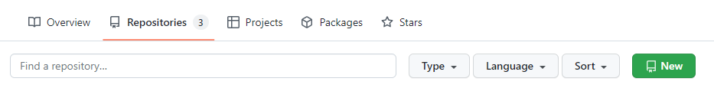
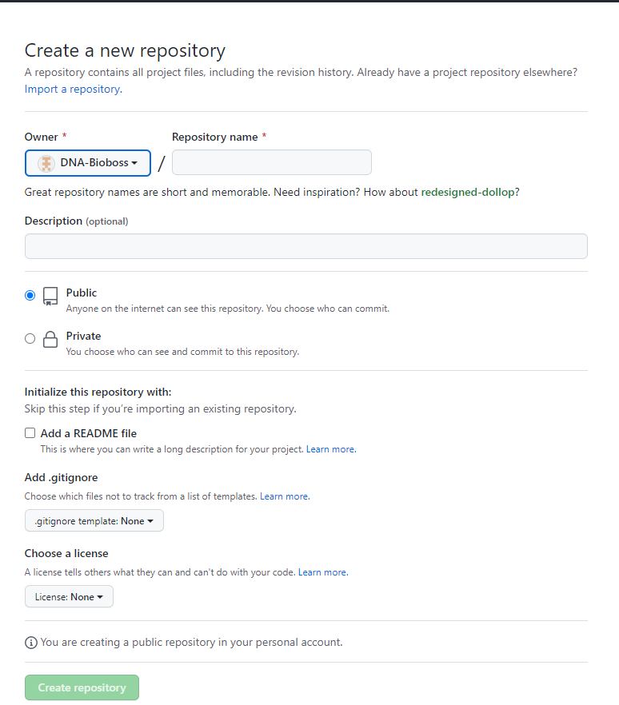
Notes:
https://github.com/halosere/KDHE-R-User-Group-Sandbox.git

Slide 12
Connecting RStudio to a GitHub Repo
Method 2: Starting with GitHub First
  Sign-in into GitHub
  Select Create a new repository
  Name your repository
  Select Create repository
  Copy the URL
  Go to RStudio
  Select File > New Project > Version Control > Git
  Paste the URL
  Select Create Project

Slide 13
Commits and Commit History
What is a Commit?
  Snapshots of your code
  Two Parts
    Files you stage
        What files to include in the “snapshot” AKA commit
    Commit message
      A brief description of how the code was change since the last commit
Commit History
  Allows you to view how your code has progressed
  “View File” allows you to view your code in from previous commits
  Unique identifier
Notes:
Each commit has a unique identifier is a marker that corresponds to each version of the code.

Slide 14

Workflow: Push and Pull
Push
  Uploading code from your RStudio Project is called Pushing.
  Represented by the upward arrow
Pull
  Downloading code from GitHub to your RStudio Project is called Pulling
  Represented by the downward arrow
Notes:
Now we have connected your RStudio Project and GitHub, you'll learn how to upload and download code from your RStudio Project and GitHub. Uploading code from your RStudio Project is called Pushing, meanwhile, downloading code from GitHub to your RStudio Project is called Pulling.
USE current existing data by baseR

Slide 15
Push
1. Select File > New File > R Script
2. Save the file as “test” plus add 3 initials: e.g. “testmxt”
3. Type the following on line 1: “Hello from local RStudio”
4. In the Environment/History Panel: Select All three files > Commit
5. Type the following onto the Commit message “Add code from RS”
6. Select Commit and close the pop-up window.
7. Select Push
8. Return and refresh your Sandbox GitHub’s webpage
Notes:
Step 4 is staging files

Slide 16
Pull
Edit the code in in your test file in your Sandbox repository in
GitHub by selecting the pencil icon.
2. Type “Hello from GitHub” on line 2
3. Select "Commit changes" at the bottom of the page
4. Return to RStudio and select the down arrow button
5. Look over at your Source Panel, “Hello from GitHub” should
appear on line 2
Notes:
Pulling downloads the most current code onto your RStudio Project from GitHub. When working with colleague, it is important to pull on a regular basis. Here, we will demonstrate pulling by using the down arrow button.

Slide 17
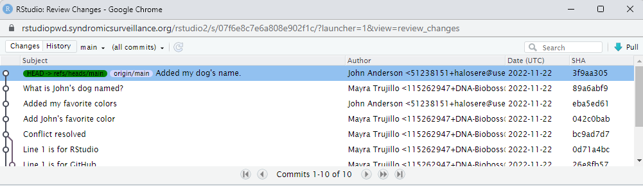
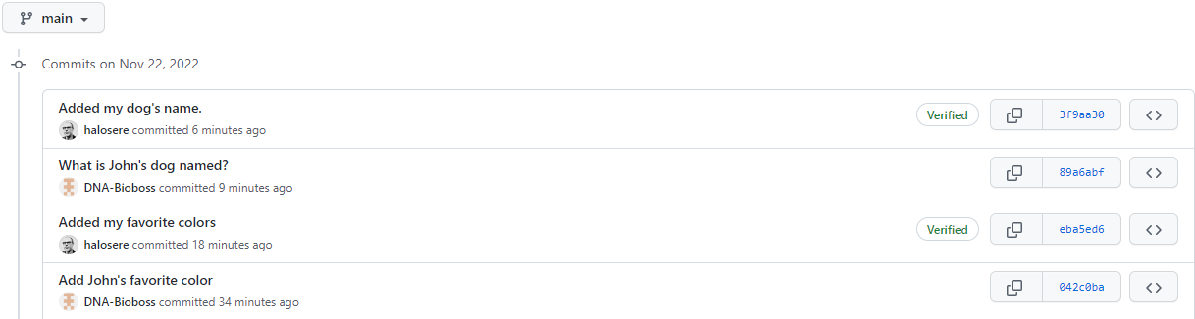

Repository Orientation: Viewing the Commit History
RStudio:
Select Git tab > History “clock icon”
GitHub:
Select Repo >

Slide 18
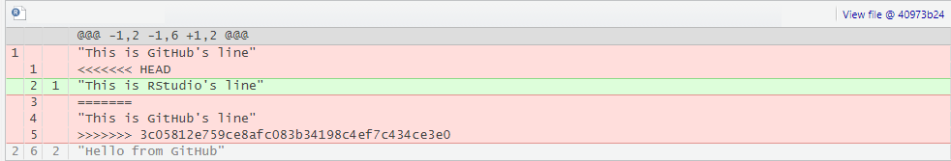
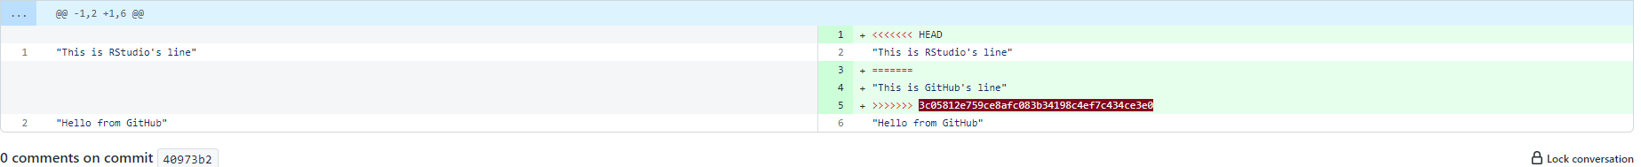
Repository Orientation: Viewing the Diffs
RStudio: Select Git tab > History “clock icon” > commit
GitHub: Select Repo > commits > unique identifier “shag”

Slide 19
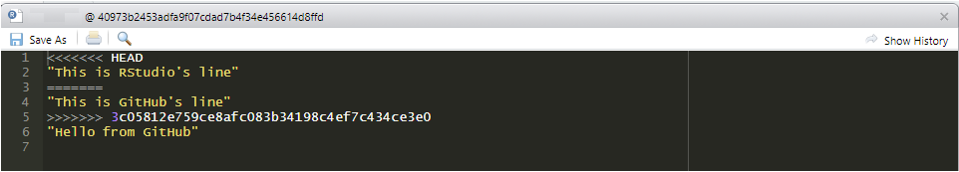
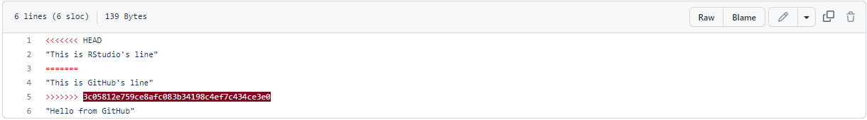
Repository Orientation: Viewing the Past versions of Code
RStudio: Select Git tab > History “clock icon” > commit > View file @ unique identifier
GitHub: Select Repo > commits > “<>” icon > select file

Slide 20
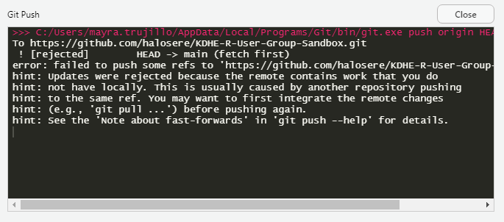
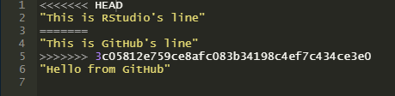
Conflicts
Occur when same code is edited on the same line
Git will show where the conflict is occurring
Notes:
Conflicts are not unique to GitHub
Keep in mind that GitHub will not create multiple copies like with dropbox but will instead present you with both codes and you’ll have to decide which code to keep.
<<<<< >>>>> conflict markers
===== conflict divider
<<<<<<<HEADER
[top code: your local code]
====
[bottom: pulled code]
The long string of letters and numbers is the commit’s unique identifier.

Slide 21
Creating a Conflict
Edit your test file in GitHub by replacing line 1 with the following: “This is GitHub’s line”
Select “Commit Changes”
Go to your test file in Rstudio and replace line 1 with the following: “This is local RStudio’s line”
Select Save > Stage (aka select) your test file > Commit > write commit message > Push
A pop-up error will appear

Slide 22
How to deal with Merge Conflicts
Close the pop-up error box
Select Pull
Remove any code you don’t want to keep
Remove the conflict markers and divider
Select Save > Stage (aka select) your test file > Commit > write commit message > Push

Slide 23
Good Practices to Avoid Conflicts
Always Pull Before Pushing
Push Early and Often
Commit Regularly
Use Branches (next presentation)

Slide 24

Thank You/Questions

Slide 25
References
R for the Rest of Us
  https://rfortherestofus.com/2021/02/how-to-use-git-github-with-r/
Simplilearn
  https://www.simplilearn.com/tutorials/git-tutorial/git-vs-github
GitHub Docs
  https://docs.github.com/en/repositories/creating-and-managing-repositories/about-repositories

